Slide 1
Why, what was the trigger to develop Design Thinking?
The term ‘design thinking’ has been part of the collective consciousness of design researchers
since Rowe used it as the title of his 1987 book (Rowe 1987). The first DTRS symposium was
an exploration of research into design and design methodology, viewed from a design thinking
perspective (Cross et al. 1992). The second DTRS symposium strove to progress multiple
understandings of design thinking by providing a common empirical basis (Cross et al. 1996).
Multiple models of design thinking have emerged over twenty years of research, based on
widely different ways of viewing design situations and using theories and models from design
methodology, psychology, education, etc. Together, these streams of research create a rich and
varied understanding of a very complicated human reality.
Nowadays, “Design Thinking” is identified as an exciting new paradigm for dealing with
problems in many professions—most notably IT (e.g., Brooks 2010) and Business (e.g., Martin
2010). This eagerness to apply design thinking has created a sudden demand for clear and
definite knowledge about design thinking (including a definition and a toolbox). This is quite
a problematic challenge for a design research community that has been shy of oversimplifying
design thinking, and cherished its multiple perspectives and rich pictures. This paper is an
attempt to systematize our knowledge of design thinking by using a model from formal logic
to describe its core challenge and reasoning patterns, and then enrich the picture by linking
some of the most prevalent notions used in various descriptions of design thinking into this
Framework.

Slide 2
What is Design Thinking?
Design Thinking is a methodology used by designers to solve complex problems, and find desirable solutions for clients.
Design Thinking draws upon logic, imagination, intuition, and systemic reasoning, to explore possibilities of what could be, and to create desired outcomes that benefit the end user (the customer). A design mindset is not problem-focused, it’s solution focused, and action oriented. It involves both analysis and imagination.
“Design is the action of bringing something new and desired into existence—a proactive stance that resolves or dissolves problematic situations by design. It is a compound of routine, adaptive and design expertise brought to bear on complex dynamic situations.” —Harold Nelson
In Short:
Finding simplicity in complexity
Beauty as well as functionality
Improving quality of experience
Creating elegant solutions
Serving the needs of people

Slide 3
Are there different forms of applications of Design Thinking
Different flavours:
Design thinking
Design driven innovation
Service Design

Slide 4
How does other companies use design thinking?

Slide 5
Design Sprint and is this related to Design Thinking

Slide 6
How does other companies use Design Sprint

Slide 7
How apply Design thinking and Design Sprint within OU

Slide 8
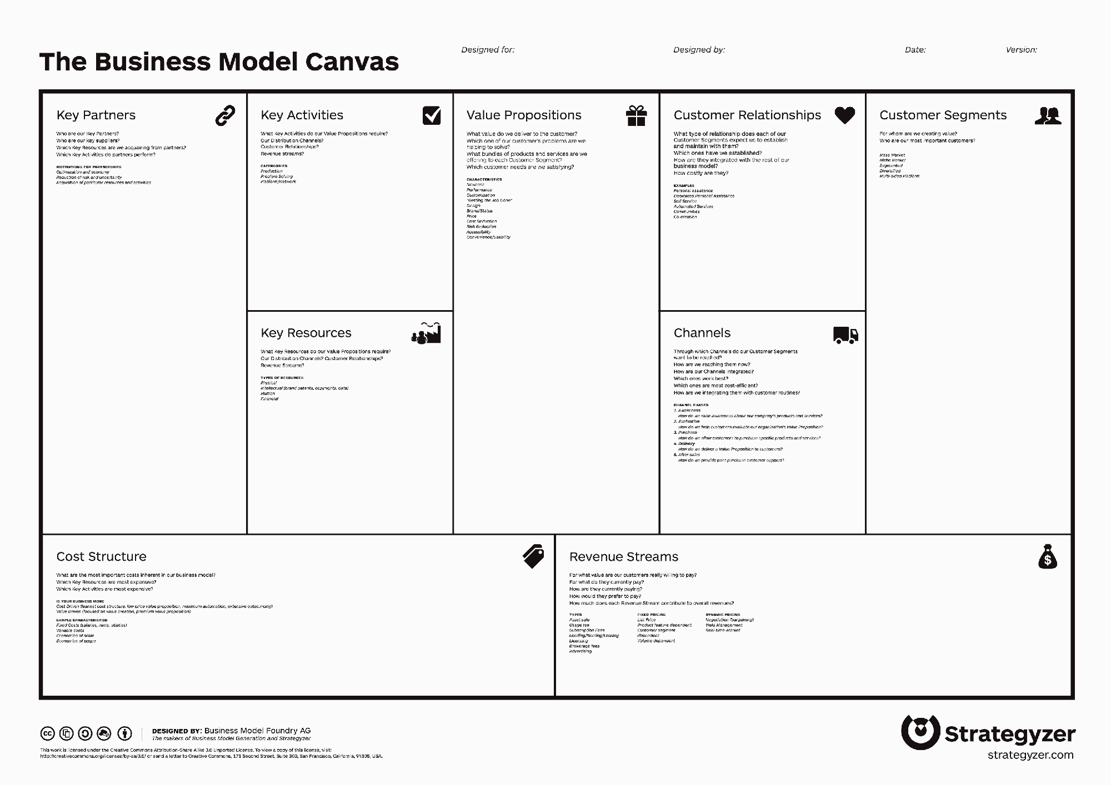
Start:

Slide 9
Start
End
Yes
Yes
Yes
Yes
Topic clear and understood?
Desired Learning intervention clear?
No need for alternatives?
Prototype the Learning Intervention (alpha phase work product)
Test with real users from pax group
No Re-work based on the outcome of the test.
No
No
No
No
Call team of GCO, SME, FAC, D&I
Create (individually) ideas
Adjust prototype
Test this with Faculty: Martin/
Bart/Ling Sian/Amit
Understand Pax: Share knowledge
Journey mapping
Create user story,
Create Design criteria
Search for conflicts between ideas
Vote for (top 3) best idea
Time lines for different approaches (DT: (5)weeks, DS: (5)days
Tools
Empathy Map
Assumption testing
Customer co-creation
Journey mapping
Notes
Rapid prototyping
Learning Launch
Value chain analysis
Cracy 8s
Mindmapping
Storyboard

Slide 10
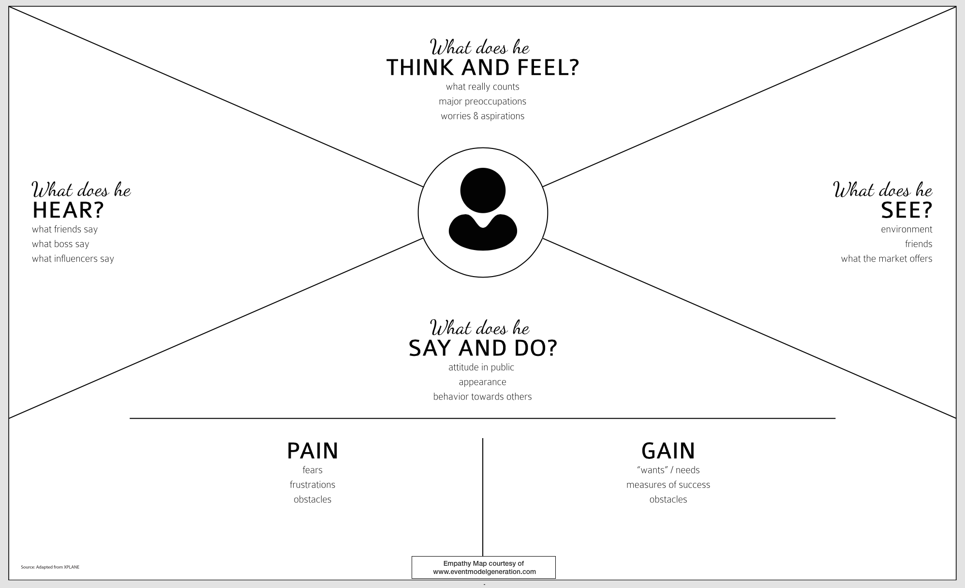
Empathy Map

Slide 11
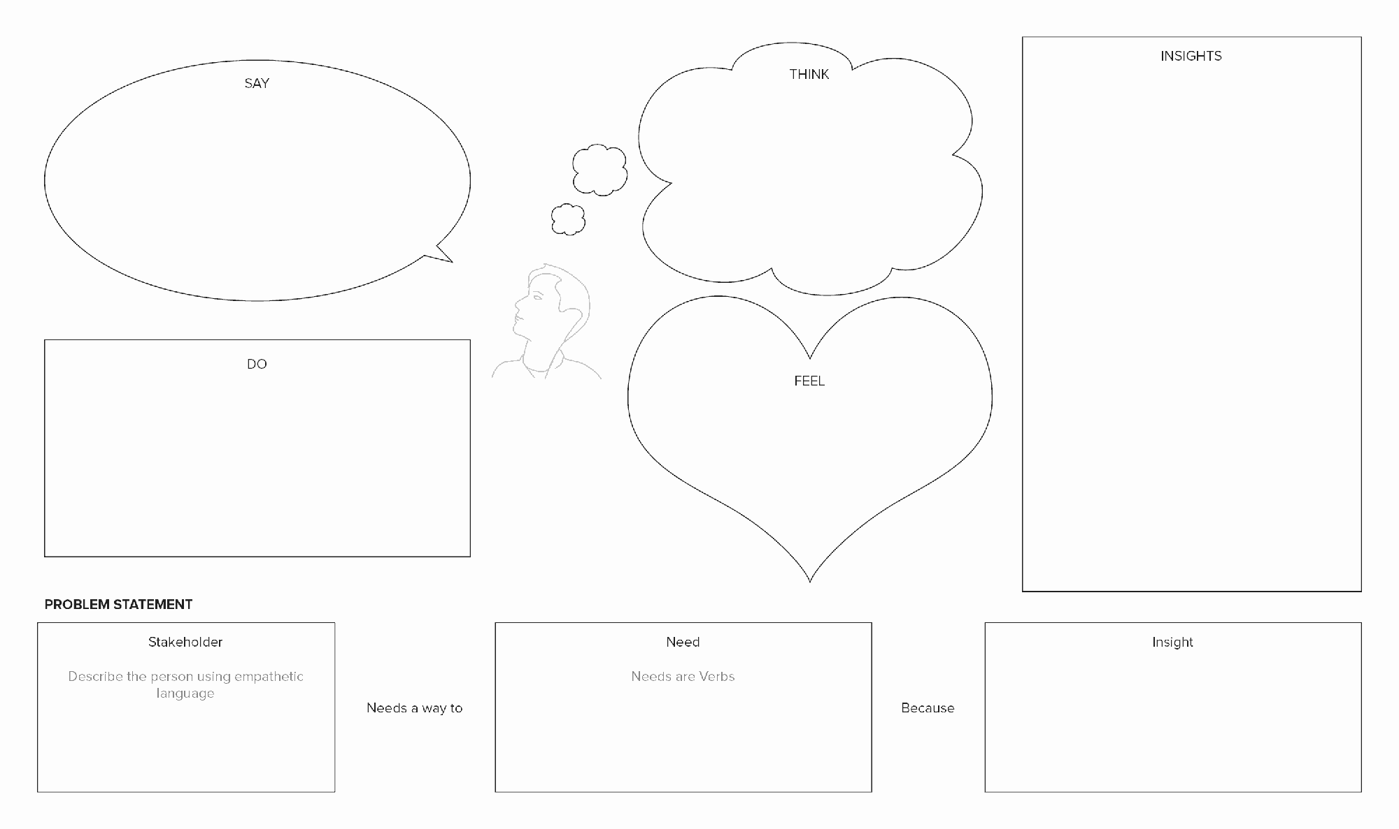
Empathy Map

Slide 12
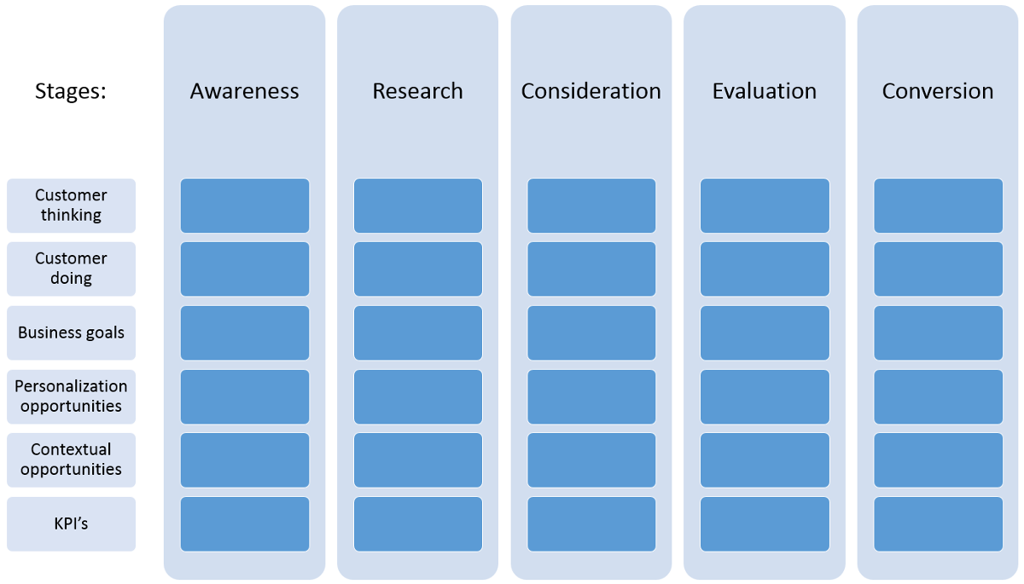
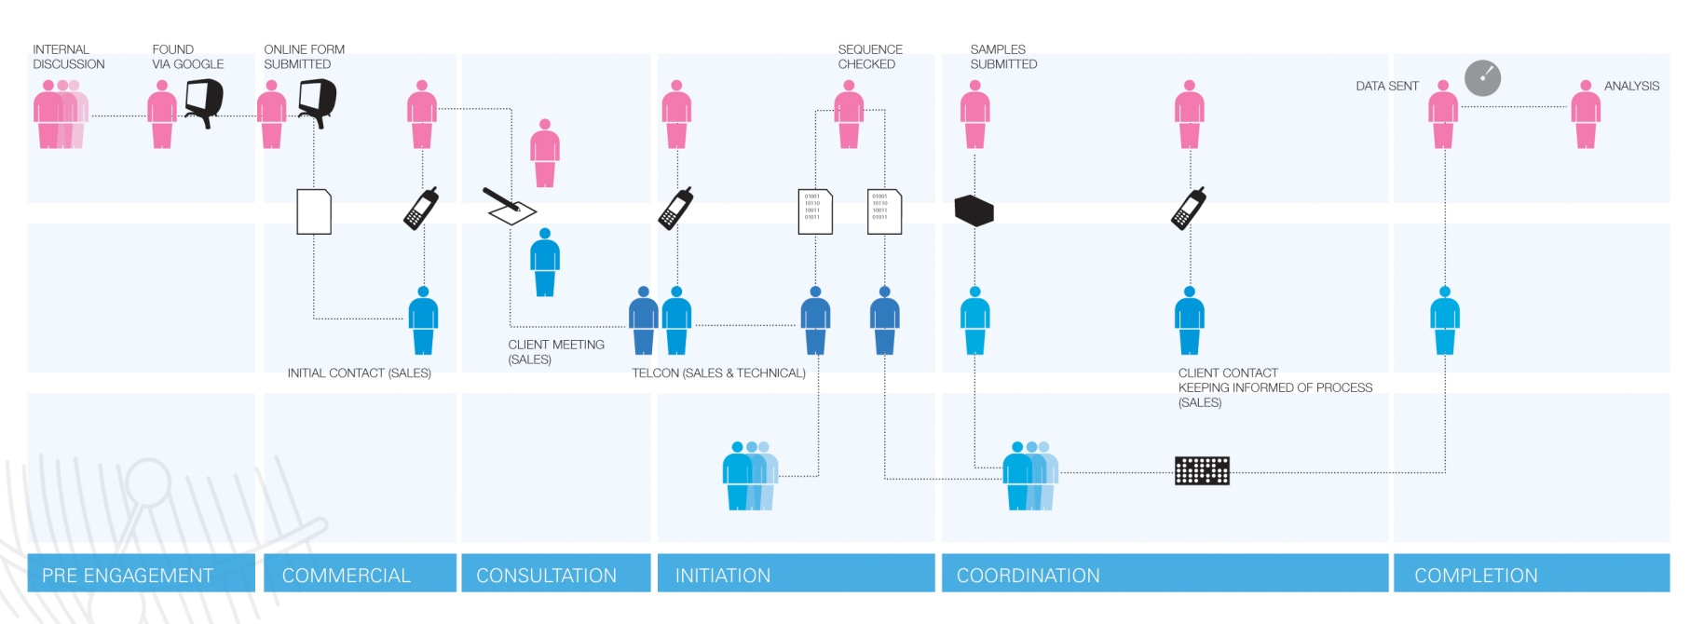
Journey Mapping

Slide 13
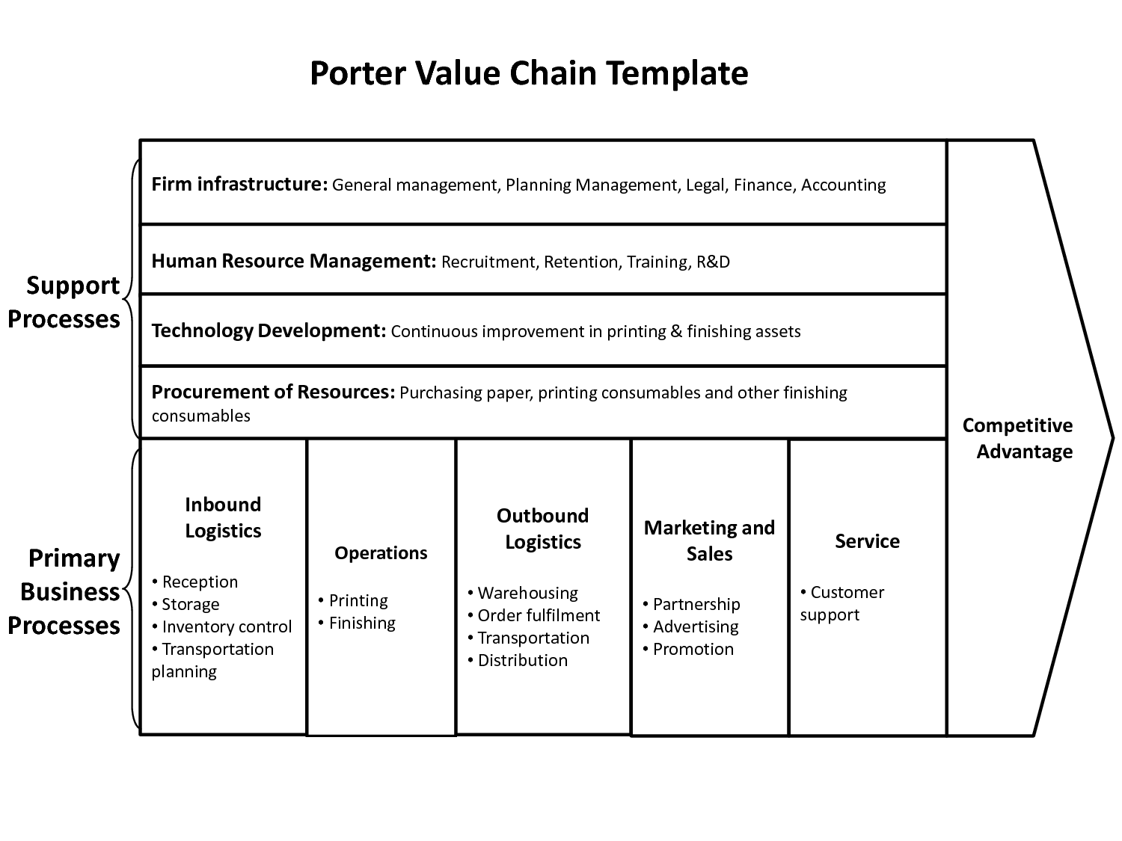
Value chain mapping

Slide 14
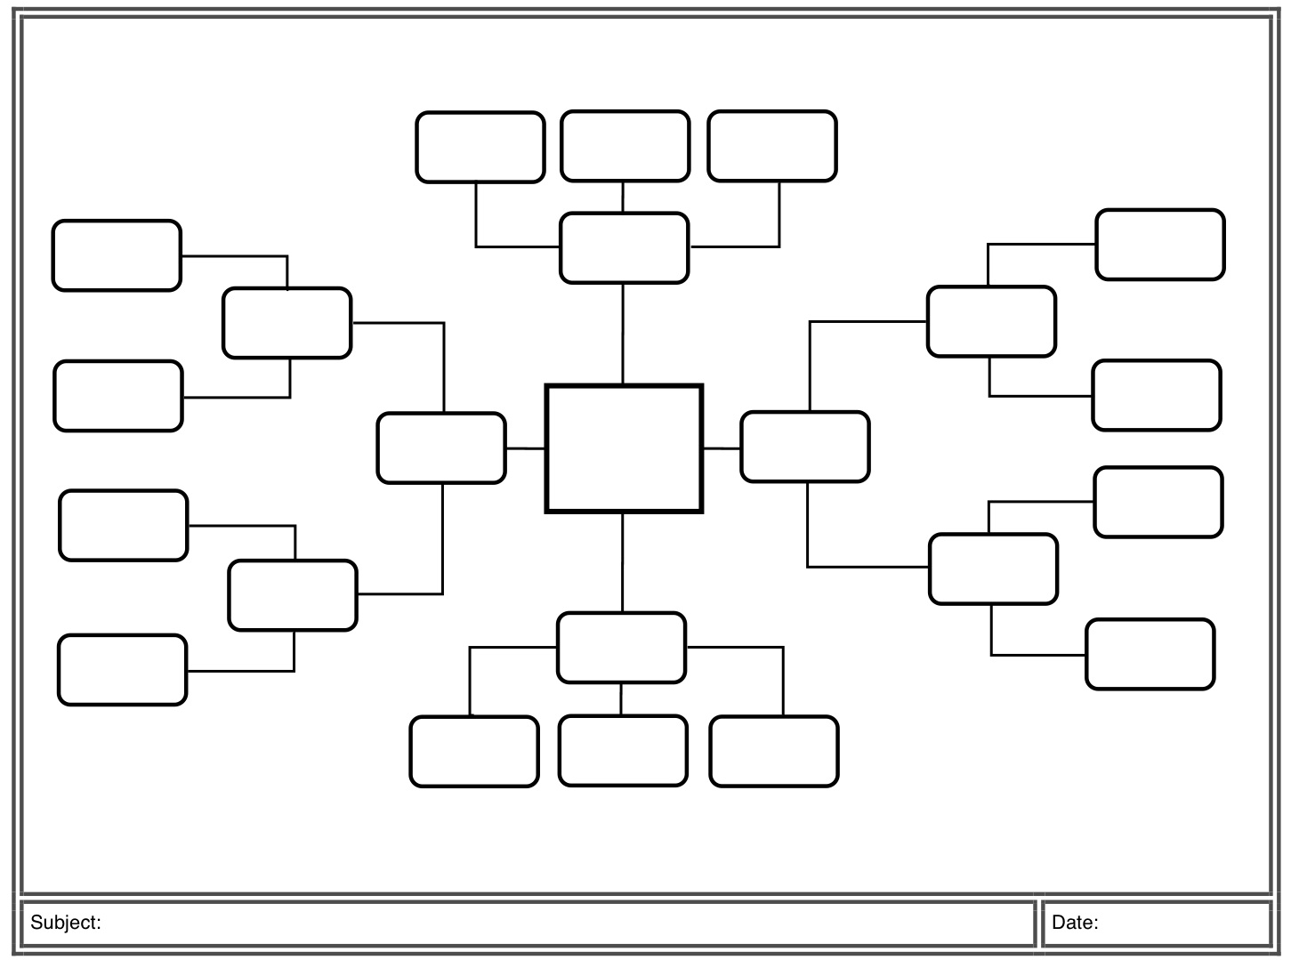
Mind Mapping

Slide 15
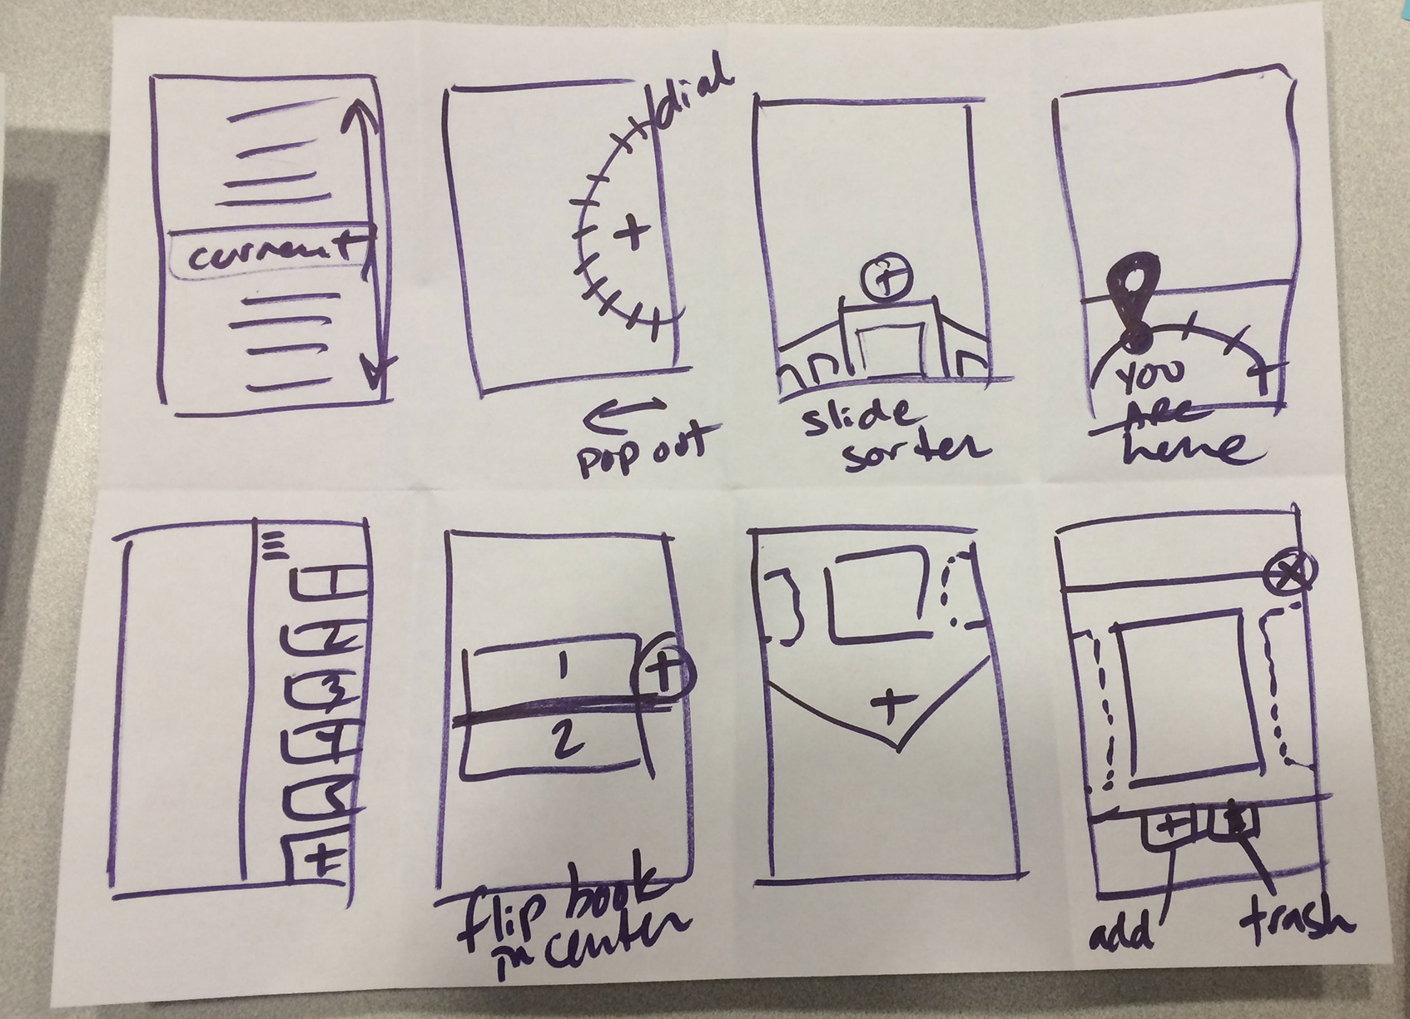
Cracy 8s

Slide 16
Rapid Prototyping

